Slide 1

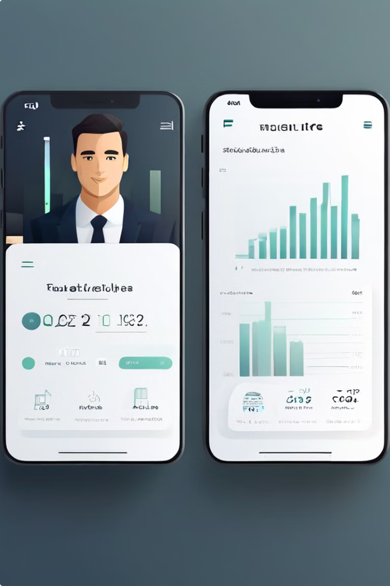


FinBuddy - Your Personal Finance Assistant
FinBuddy is an AI-powered personal finance assistant designed to simplify, save, and grow your wealth.
by Siyabonga Ntshingila

Slide 2

The Financial Management Problem
1
Financial Literacy Gap
Many individuals struggle to manage their finances effectively due to a lack of financial literacy.
2
Poor Budgeting Habits
Without proper financial literacy, people often struggle with budgeting and saving habits.
3
Complexity of Financial Planning
The complexity of financial planning deters people from setting and achieving financial goals.

Slide 3

FinBuddy - The Solution to Your Financial Woes
Personalized Financial Advice
FinBuddy provides AI-powered personalized financial advice tailored to your individual needs and goals.
Easy-to-Use Budgeting Tools
FinBuddy offers easy-to-use budgeting tools and expense tracking features to help you manage your finances effectively.
Goal-Setting Features
FinBuddy helps you set financial goals with actionable steps and progress tracking to keep you motivated.
Automated Savings Plans
FinBuddy offers automated savings plans and investment suggestions to help you grow your wealth.

Slide 4

A Lucrative Market
1
Global Market Growth
The global personal finance market is projected to reach $1.8 billion by 2026.
2
Digital Adoption
Millennials and Gen Z are increasingly adopting digital financial tools.
3
Growing Demand
There is a growing demand for accessible financial education and management tools.

Slide 5
Key Features of FinBuddy
Personalized Dashboard
Budgeting Tool
Expense Tracker
Provides a comprehensive overview of your financial health, including your budget, spending, savings, and investments.
Helps you create and stick to a budget with ease, allowing you to track your income and expenses.
Monitors your spending in real-time, providing insights into your spending habits and helping you identify areas for improvement.

Slide 6

How FinBuddy Makes Money
Freemium Model
Basic features available for free, premium features on subscription basis.
Premium Subscriptions
$9.99/month or $99/year for advanced tools and personalized advice.
Affiliate Partnerships
Commissions from financial product recommendations.
In-app Purchases
Additional tools and educational resources.

Slide 7





Our Progress So Far
Beta Launch
Successful beta testing with 10,000+ users.
User Growth
20% month-over-month user growth.
Engagement
High user retention and positive feedback.
Partnerships
Collaborations with financial advisors and institutions.

Slide 8




Investment Opportunity
Amount Sought
$2 million in seed funding.
Use of Funds
Product development, marketing and user acquisition, hiring key personnel, operational expenses.
Investor Benefits
Equity stake, potential for high returns, opportunity to support financial literacy and empowerment.

